Slide 1
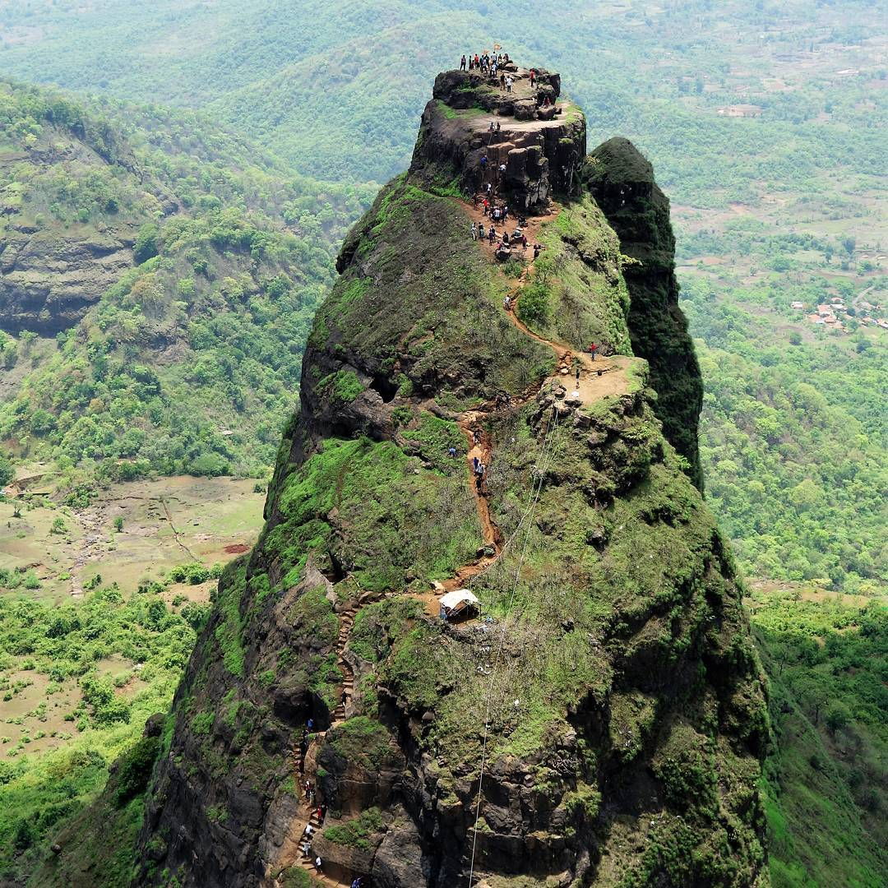
MAHARASTRA TREKKING CLUB
PRESENTS
KALAVANTIN DURG
17TH DEC 2017
PUNE
Prathamesh :- 8698350315
Viraj :- 9011846447
MUMBAI
Fees :-800
Fees :-600
mahatrekk.in

